Slide 1


Slide 2
ELECTICIDER
An Electronic Voting System

Slide 3
What is Electicider? (ELECTion + deCIDER)
Electicider is basically an electronic voting system .It is GUI application mainly created using a built-in python library called tkinter. Its name is the amalgamation of two words ‘ELECTION’ and ‘DECIDER’ . Although it is not a web application but it does need constant internet access. It has been originally designed to conduct on-campus elections where the candidates are students.

Slide 4
Purpose of Electicider
Electicider is mainly built for:-
Conduction of smooth on-campus election
Encouraging the students to vote by ensuring transparency.
Obtaining the feedback of the voters regarding the election campaign and
the candidate chosen by them.

Slide 5
Why electicider is different?
Electicider
Common voting system
Benefits:-
Graphical User Interface
Transparency
Cost efficient
Easy to use
Minimal manual effort required
Environment friendly
Drawbacks:-
Non-interactive
Not cost friendly
Greater chance of fraud or manipulation.
Wastage of paper and other stationery.
Long and tiring process.

Slide 6
Functionality

Slide 7
Libraries used in Electicider
Back End Python programming:-
Smtplib
Imaplib
Openpyxl
Email.mime and email.
Front End programming:-
Tkinter
Time
PIL(Python Imaging Library)
ScrolledText

Slide 8
Working of Electicider
Receipt counter:-
Obtaining voter data.
Matching it with the student data stored in a local excel file.
Generating a receipt number and emailing an electronic receipt to the voter and computer used in the voting booth.
Voting booth:-
Fetching data from the user.
Comparing it with the data obtained in the e-mail.
Allowing the user to vote.
Obtaining the user feedback.
Electicider works at 2 different places:
1.At the receipt counter ,our official obtains user details and matches it against the stored record of enrolled students using openpyxl and upon verification of the user credentials .It uses smtplib to send an electronic receipt through email containing a unique receipt number.
2.In the voting booth when the user enters the data in the receipt sent to him,electicider reads the e-mail sent to booth’s computer using imaplib and email libraries and checks if the data entered by the user exists in the email received by it.
Upon verification,voter is allowed to vote and in the end user feedback is obtained.

Slide 9
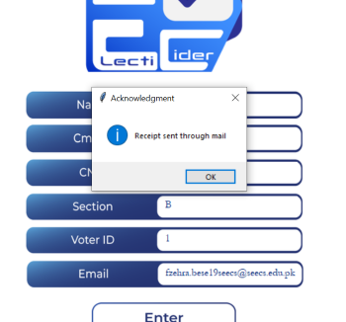
Emailer
Our official will tell the voter that his credentials have been verified upon acknowledgment.

Slide 10
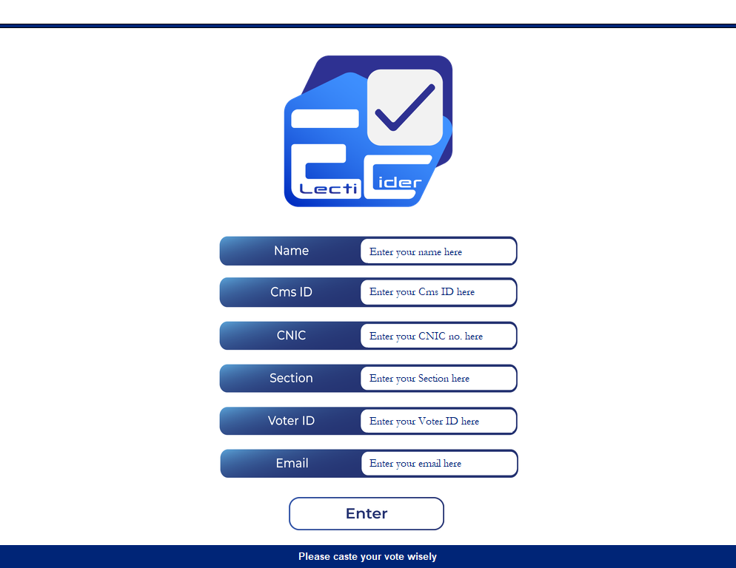
Receipt generator
Receipt generator fetches user credentials and compares it with the data in the locally stored excel file.

Slide 11
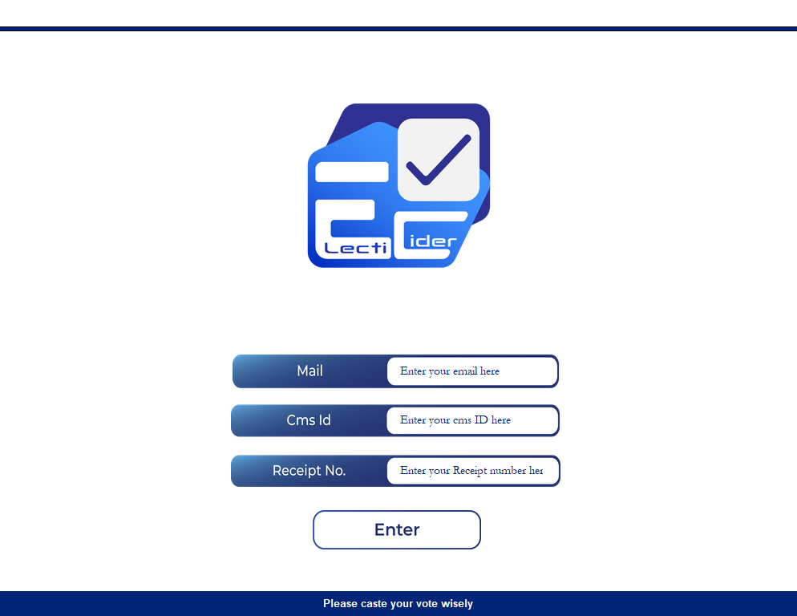
Login page
It is displayed in the voting booth and is used to fetch data sent to the voter through an e-mail.

Slide 12
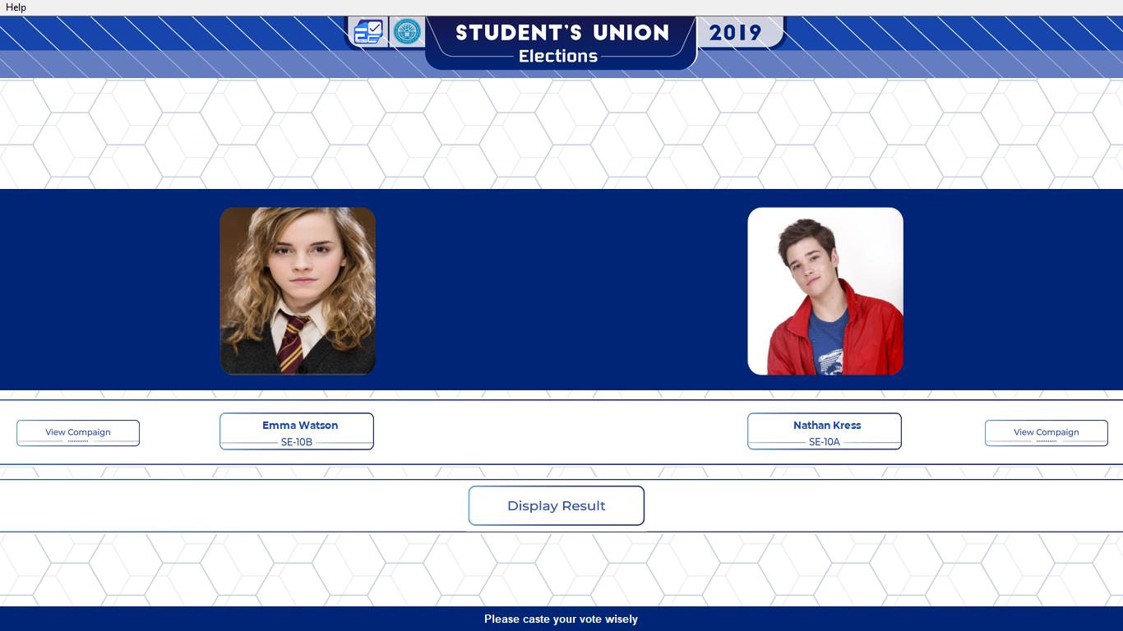
Voter window
This is the window where the voter castes his vote by clicking on the named buttons. It also allows user to view the campaign of the candidate on the go

Slide 13
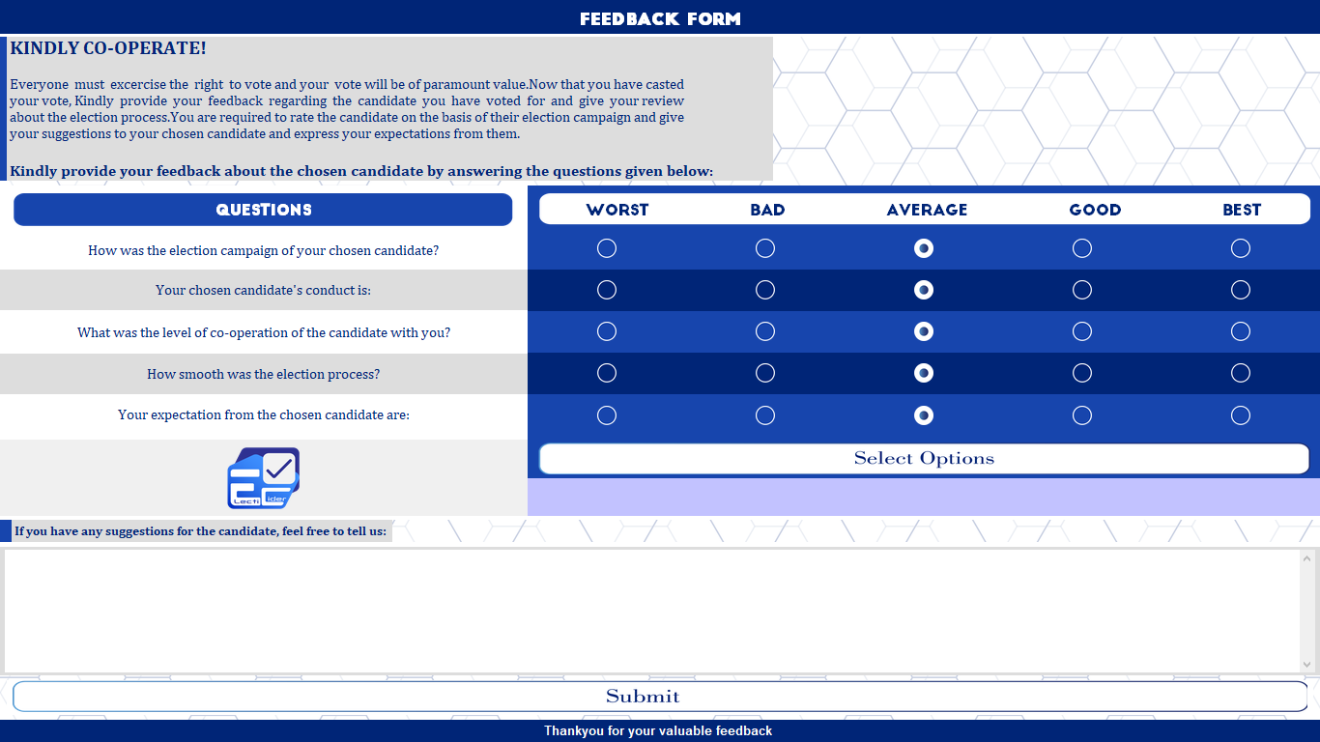
Feedback form
Feedback of the voter is obtained and saved using file handling to be aware of the expectations and feedback of the user regarding the candidate and election campaign.

Slide 14
User INTERFACE

Slide 15
Functions of Libraries used
Tkinter
It is used for developing the graphical user interface (GUI).
It is the core module behind Electicider
PIL(Python Imaging Library)
PILLOW or more commonly known as PIL is used to import images and resize them at the same time in python
ScrolledText
Used to make a scrollable entry box for large inputs
Time
It is used to refresh and produce smooth animations for aesthetics

Slide 16
Custom Radio Buttons
Radio buttons are custom designed to match the theme of the program and improve the visuals, also helping user to notice them as they are larger than the stock radio buttons

Slide 17
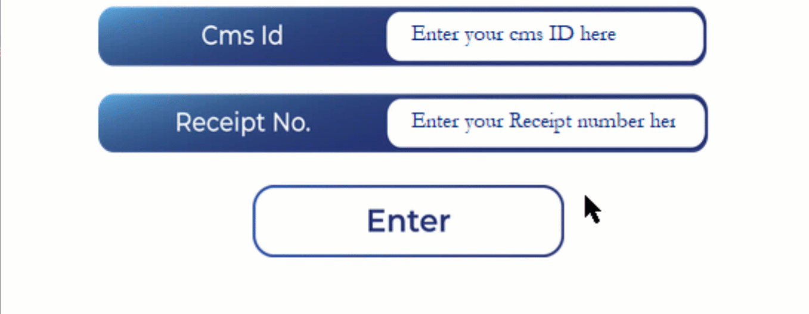
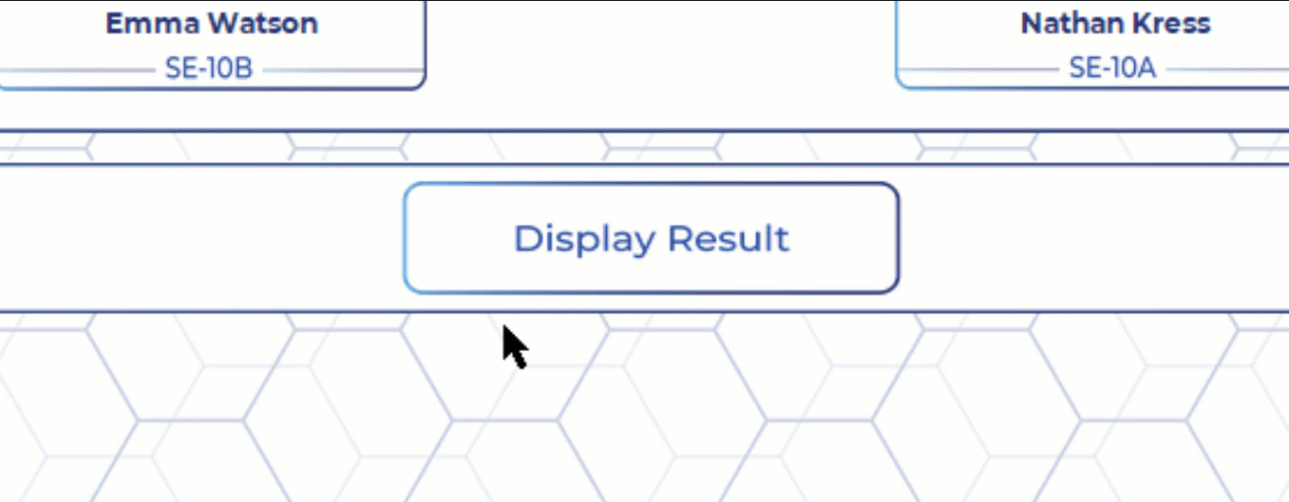
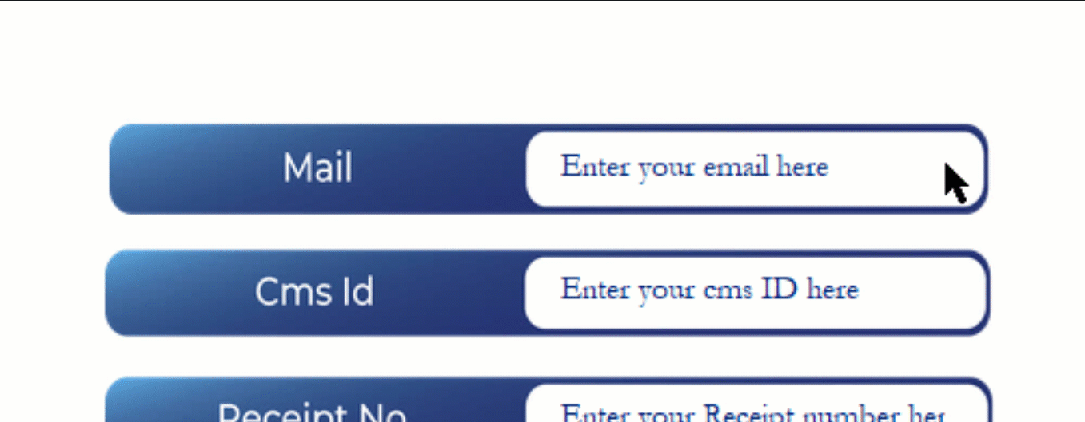
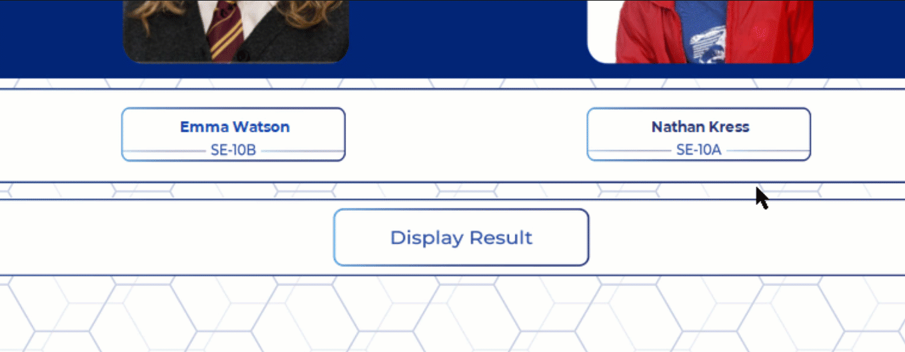
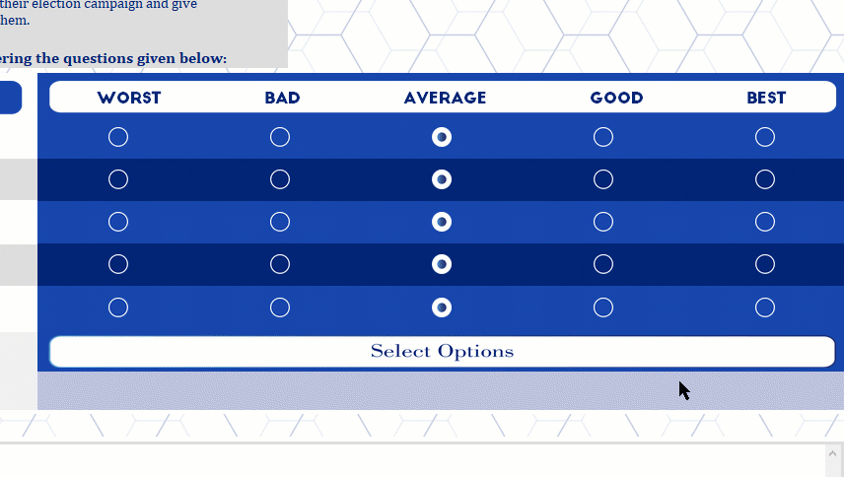

Hover Effects
Interactive Buttons change when pointer moves over them, so that user can instantly know the button is interactable, making the user experience seamless

Slide 18
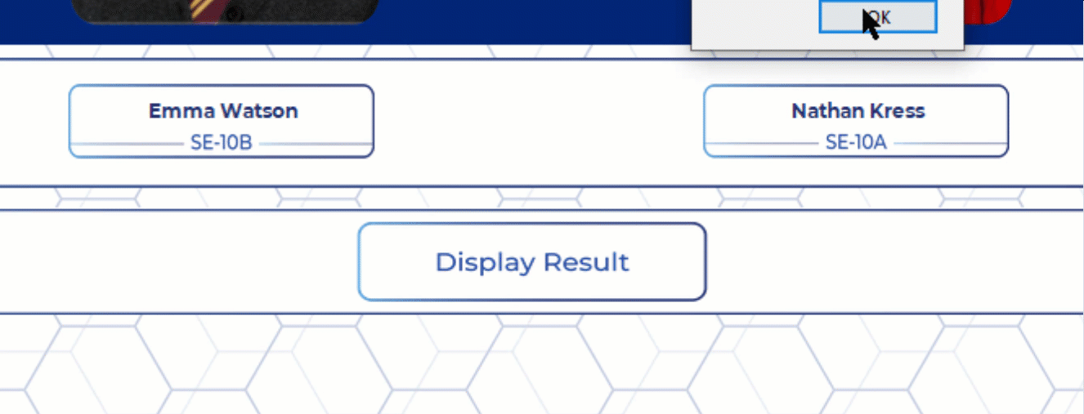
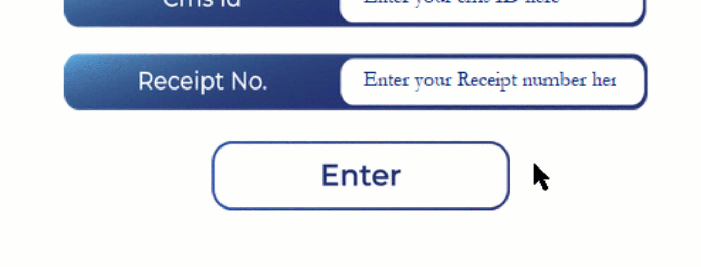
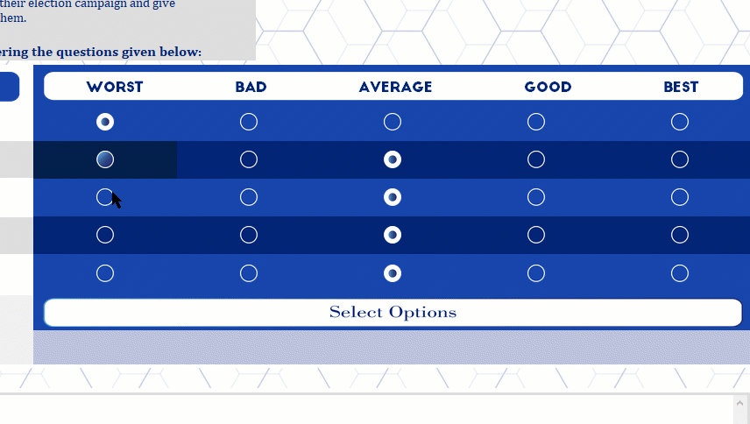
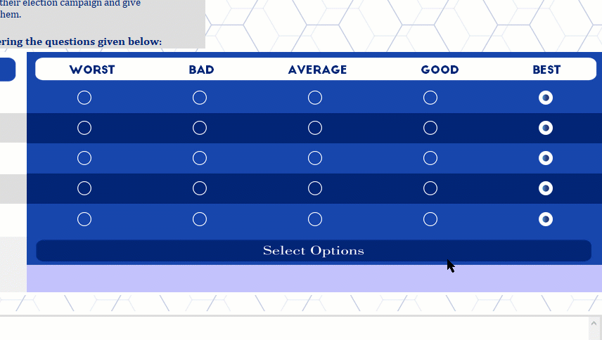
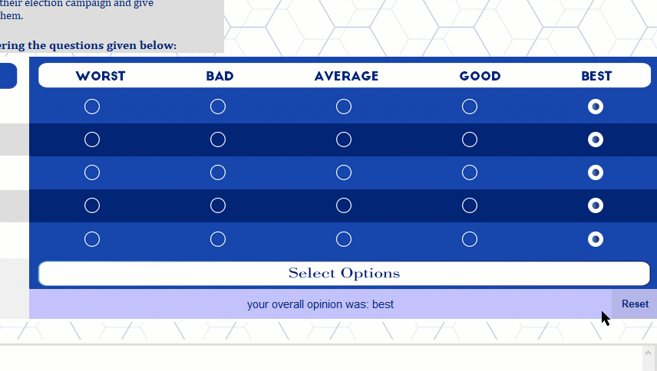
Click effects
Interactive Buttons change when clicked, so that user can instantly know It has been pressed, enhancing user experience

Slide 19
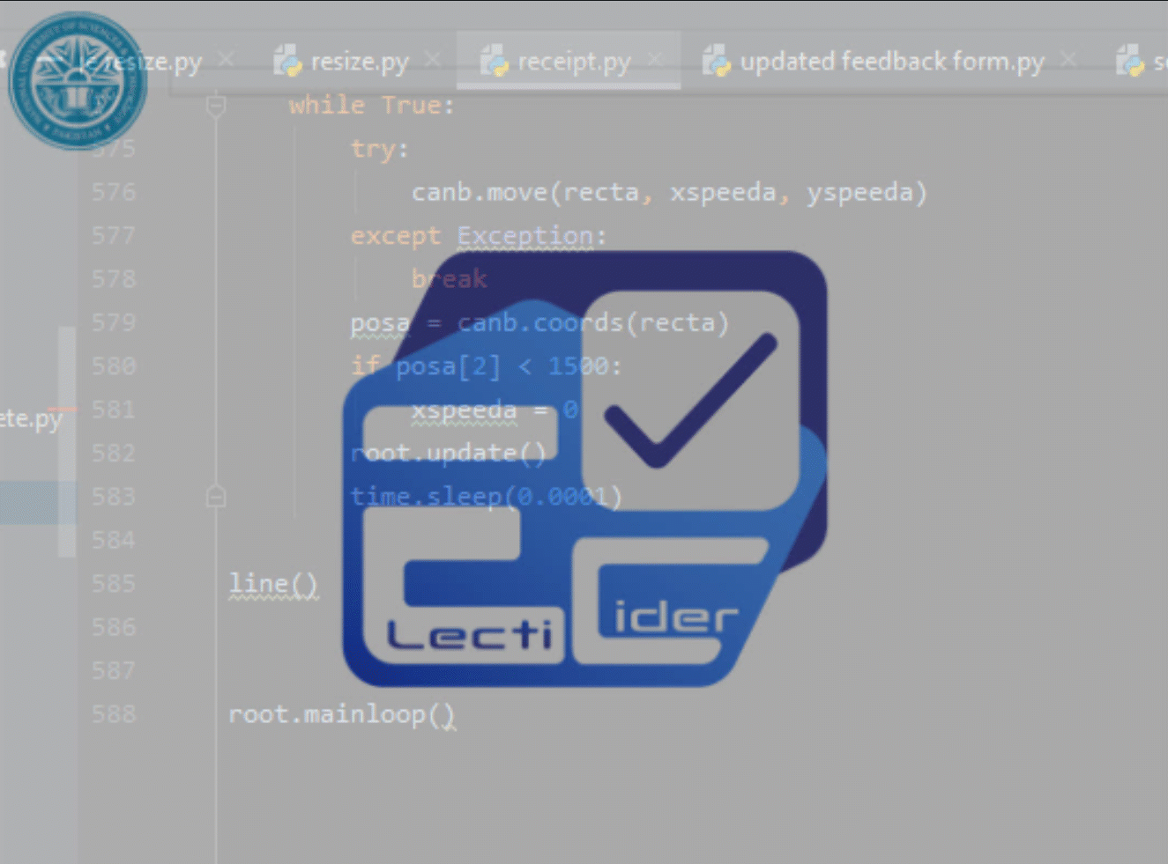
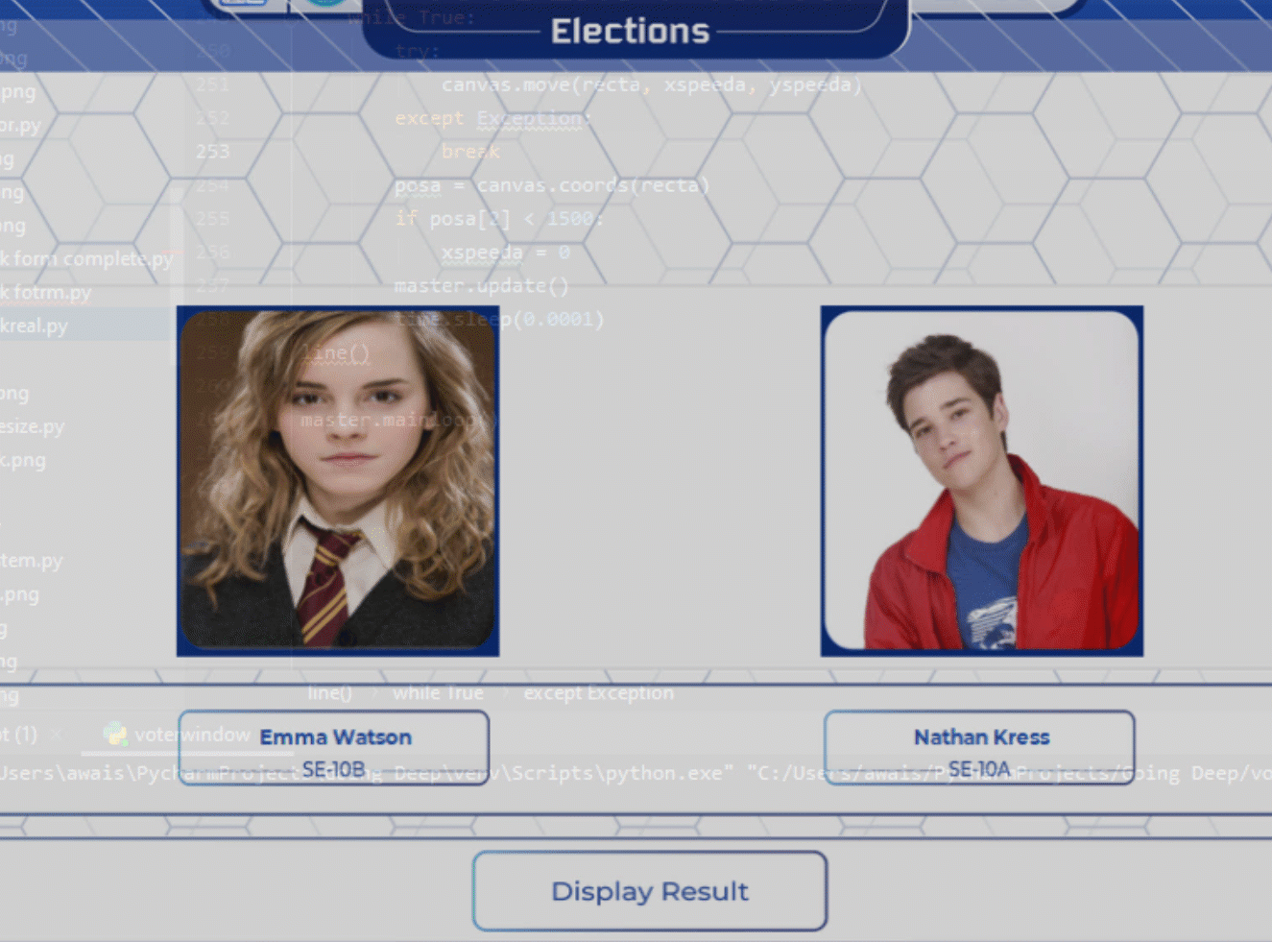
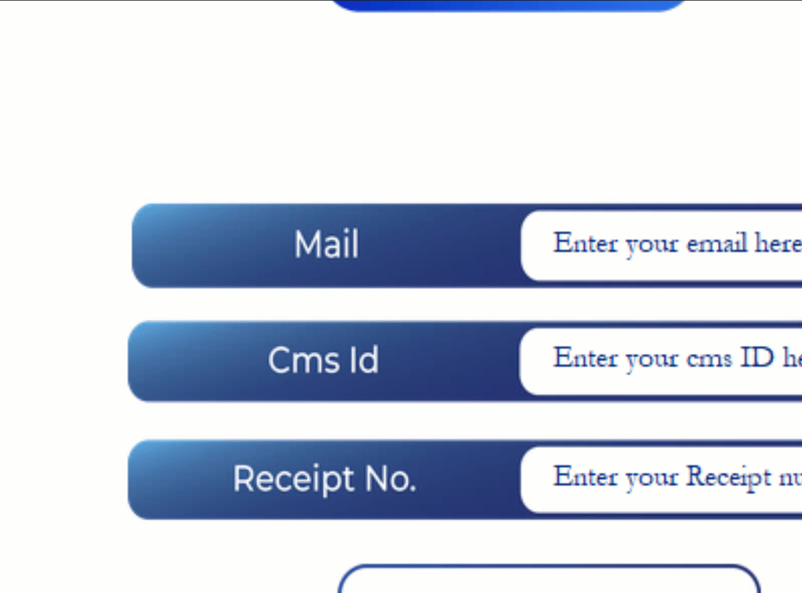
Aesthetic Animations
They Boost the aesthetics of the program making it pleasing to the eye, getting user’s attention and giving a sense of life to the program.

Slide 20
Thank You!

Slide 21
Questions?

